Slide 1


Shark Tank India: Deal Dynamics & Investor Behavior Analysis
An end-to-end data analytics deep dive using Python, Pandas, NumPy & Matplotlib
Presented by: Rupnath Shaw
PYTHON ANALYTICS
DATA-DRIVEN INSIGHTS

Slide 2

Business Context & Problem Statement
The Reality
Core Questions
Shark Tank India offers startups a critical funding opportunity — yet many pitches fail, and successful deals often close on drastically different terms than founders expect.
What differentiates successful vs. failed pitches?
How do ask amount, equity & valuation affect outcomes?
Do sharks follow consistent investment patterns?
Understanding what separates winners from losers is essential for both entrepreneurs and investors.
What negotiation dynamics truly drive deals?

Slide 3
Dataset Overview
117
28
1
Total Pitches
Features Analyzed
Granularity Level
Comprehensive coverage of Season 1 funding opportunities
Rich multidimensional data across pitch & deal metrics
One row equals one complete pitch interaction
Pitch Expectations
Ask amount, equity requests, initial valuations
Deal Outcomes
Final amounts, equity given, negotiated valuations
Shark Behavior
Presence indicators, investment patterns, decision metrics
Derived Metrics
Capital efficiency, negotiation shifts, performance ratios

Slide 4
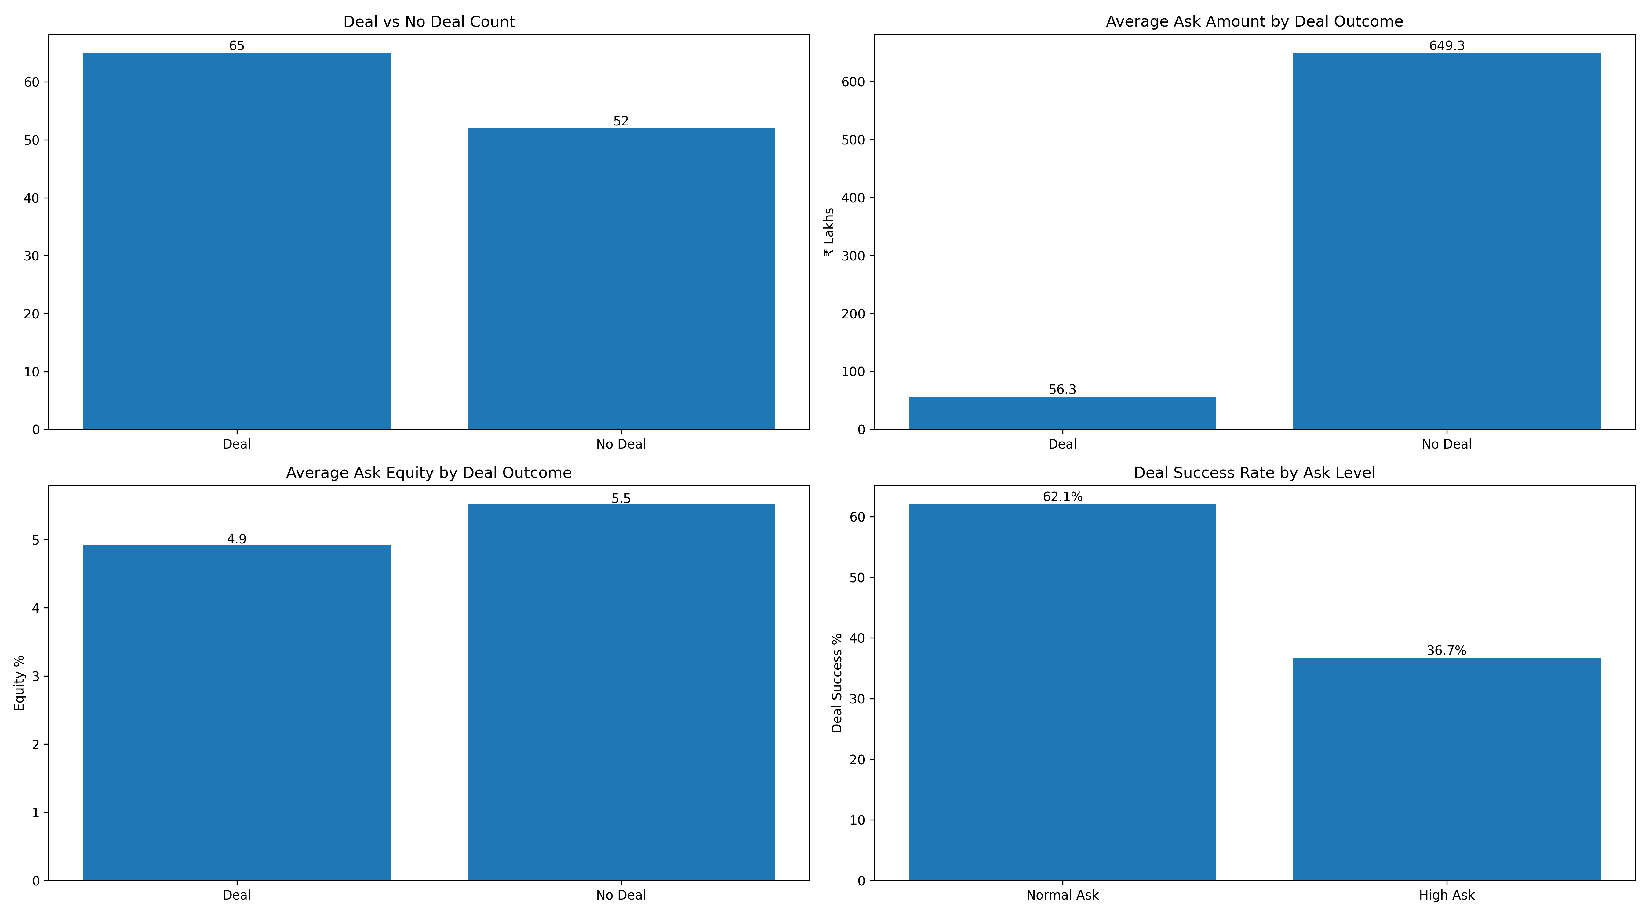

DEAL OUTCOMES
Deal Success & Pitch Behavior Patterns
High Asks = Low Success
Aggressive funding requests show dramatically lower deal conversion rates
Equity Paradox
Lower equity offers do not guarantee success — business fundamentals matter more
Expectation Management
Sharks heavily penalize unrealistic valuations and inflated capital needs
Critical Insight: Sharks prioritize business viability over pitch aggression — founders must balance ambition with market reality.

Slide 5
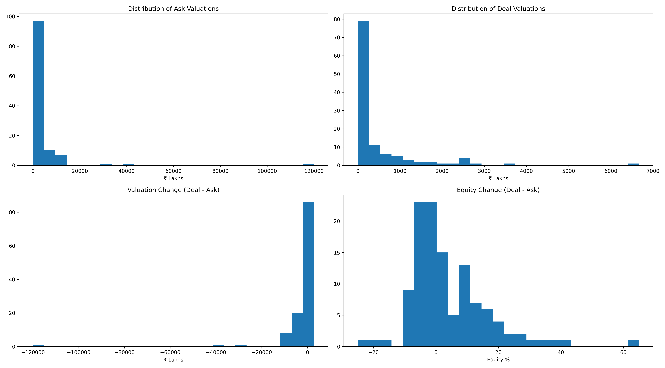
VALUATION REALITY
Valuation & Negotiation Dynamics
Ask Valuations Heavily Right-Skewed
Deal Valuations Consistently Lower
Final valuations average 30-40% below initial asks
Founders consistently overvalue their startups relative to market benchmarks
Negative Valuation Change is the Norm
Majority of deals involve downward correction — rarely upward revision
Founder Ask
Negotiation
Final Deal
Optimistic valuation based on potential
Reality check meets market validation
Founders accept higher dilution for capital access
Bottom Line: Negotiation almost always favors sharks — valuation correction is standard practice, not exception.

Slide 6
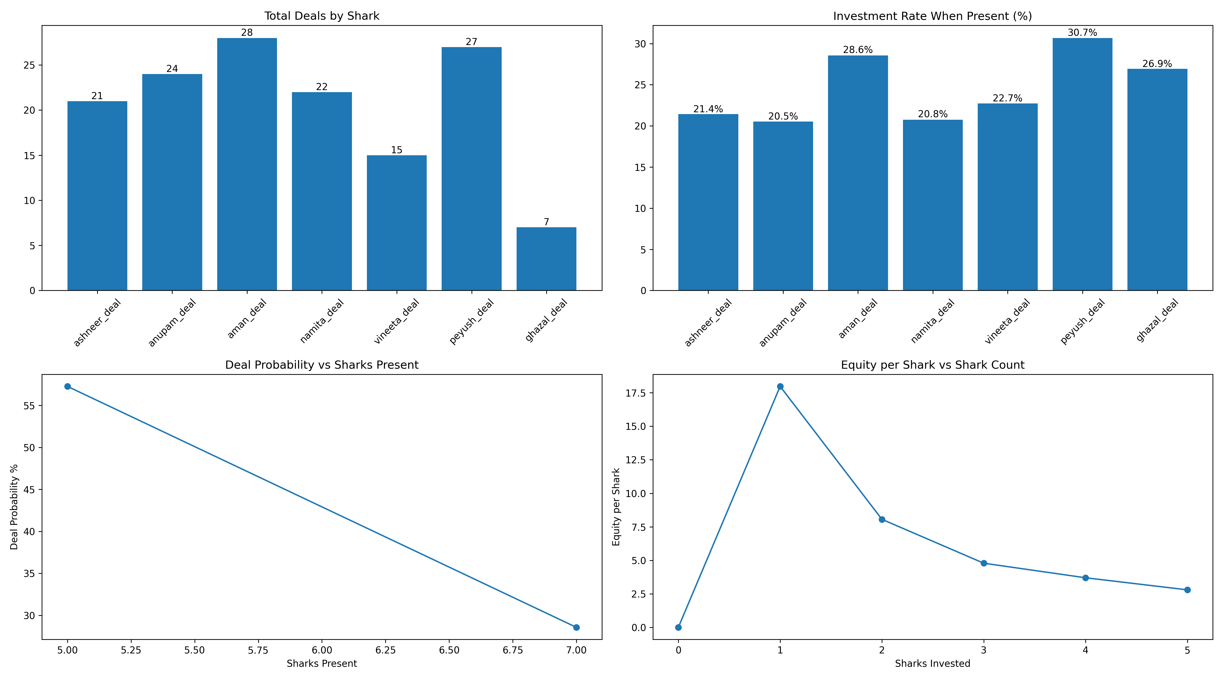

Shark Investment Behavior Analysis
Distinct Investment Styles
Presence ≠ Investment
Conviction-Driven Deployment
Being present on the panel does not correlate directly with deal participation — selective criteria apply
Each shark follows a unique investment philosophy — some focus on volume, others on selective high-conviction bets
Highest investment rates occur when business alignment and growth potential are crystal clear
Data-Driven Decisions
Strategic Positioning
Investment choices reflect rigorous evaluation of metrics, market fit, and founder capability
Sharks seek portfolio diversification and sector-specific expertise alignment
Key Takeaway: Sharks follow individual strategies, not uniform decision rules — understanding each investor's thesis is critical.

Slide 7
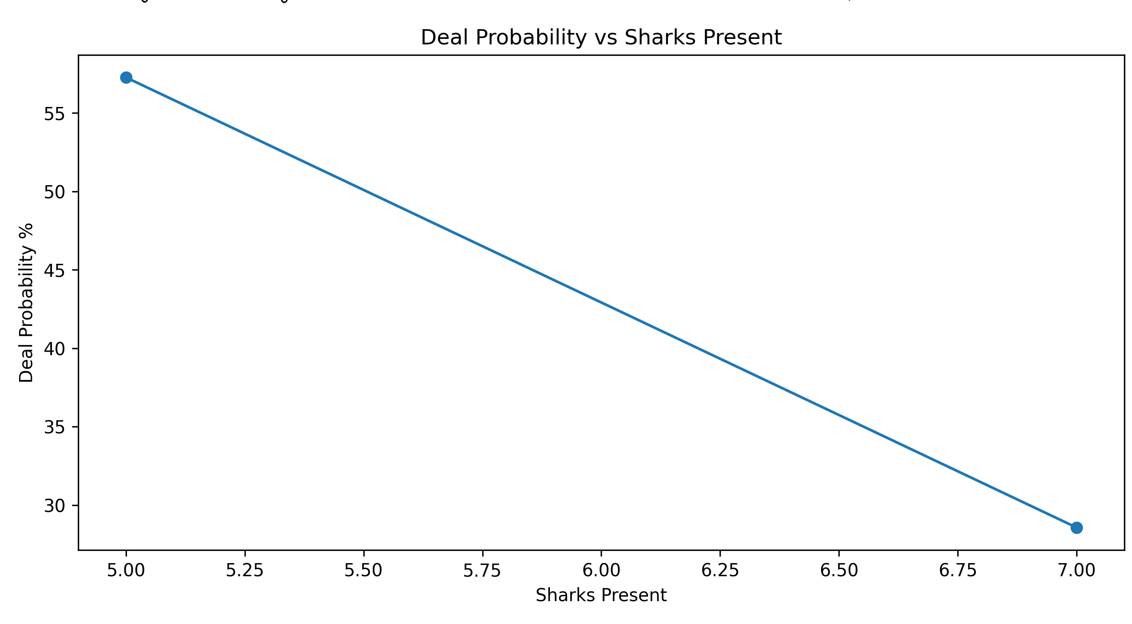
PANEL DYNAMICS
Sharks Present vs. Deal Probability
Non-Linear Relationship
Panel Size Myth
Deal probability does not increase proportionally with panel size
More sharks present ≠ guaranteed deal — quality trumps quantity
Pitch Quality Dominates
Weak business models fail even with full panel presence — fundamentals matter most
Critical Insight: Deal success depends on business strength and market fit, not panel composition.

Slide 8

Capital Efficiency & Deal Structure
Calculate Efficiency Ratio
Analyze Multi-Shark Dynamics
Rupees deployed per 1% equity given
How equity splits across multiple investors
Compare Deal Quality
Identify optimal capital-to-dilution ratios
Wide Efficiency Variation
Best Deals Maximize ₹ per 1% Equity
Capital efficiency ranges dramatically — some deals deliver 3x better value per equity point
Top performers secure maximum capital with minimal dilution — smart negotiation pays off
Multi-Shark Trade-offs
Efficiency Decline Pattern
Adding sharks reduces equity per investor but often decreases overall efficiency
As shark count increases, per-equity capital often drops — more isn't always better
Strategic Insight: The best deals prioritize efficiency over size — founders should optimize capital per dilution point, not just headline amounts.

Slide 9
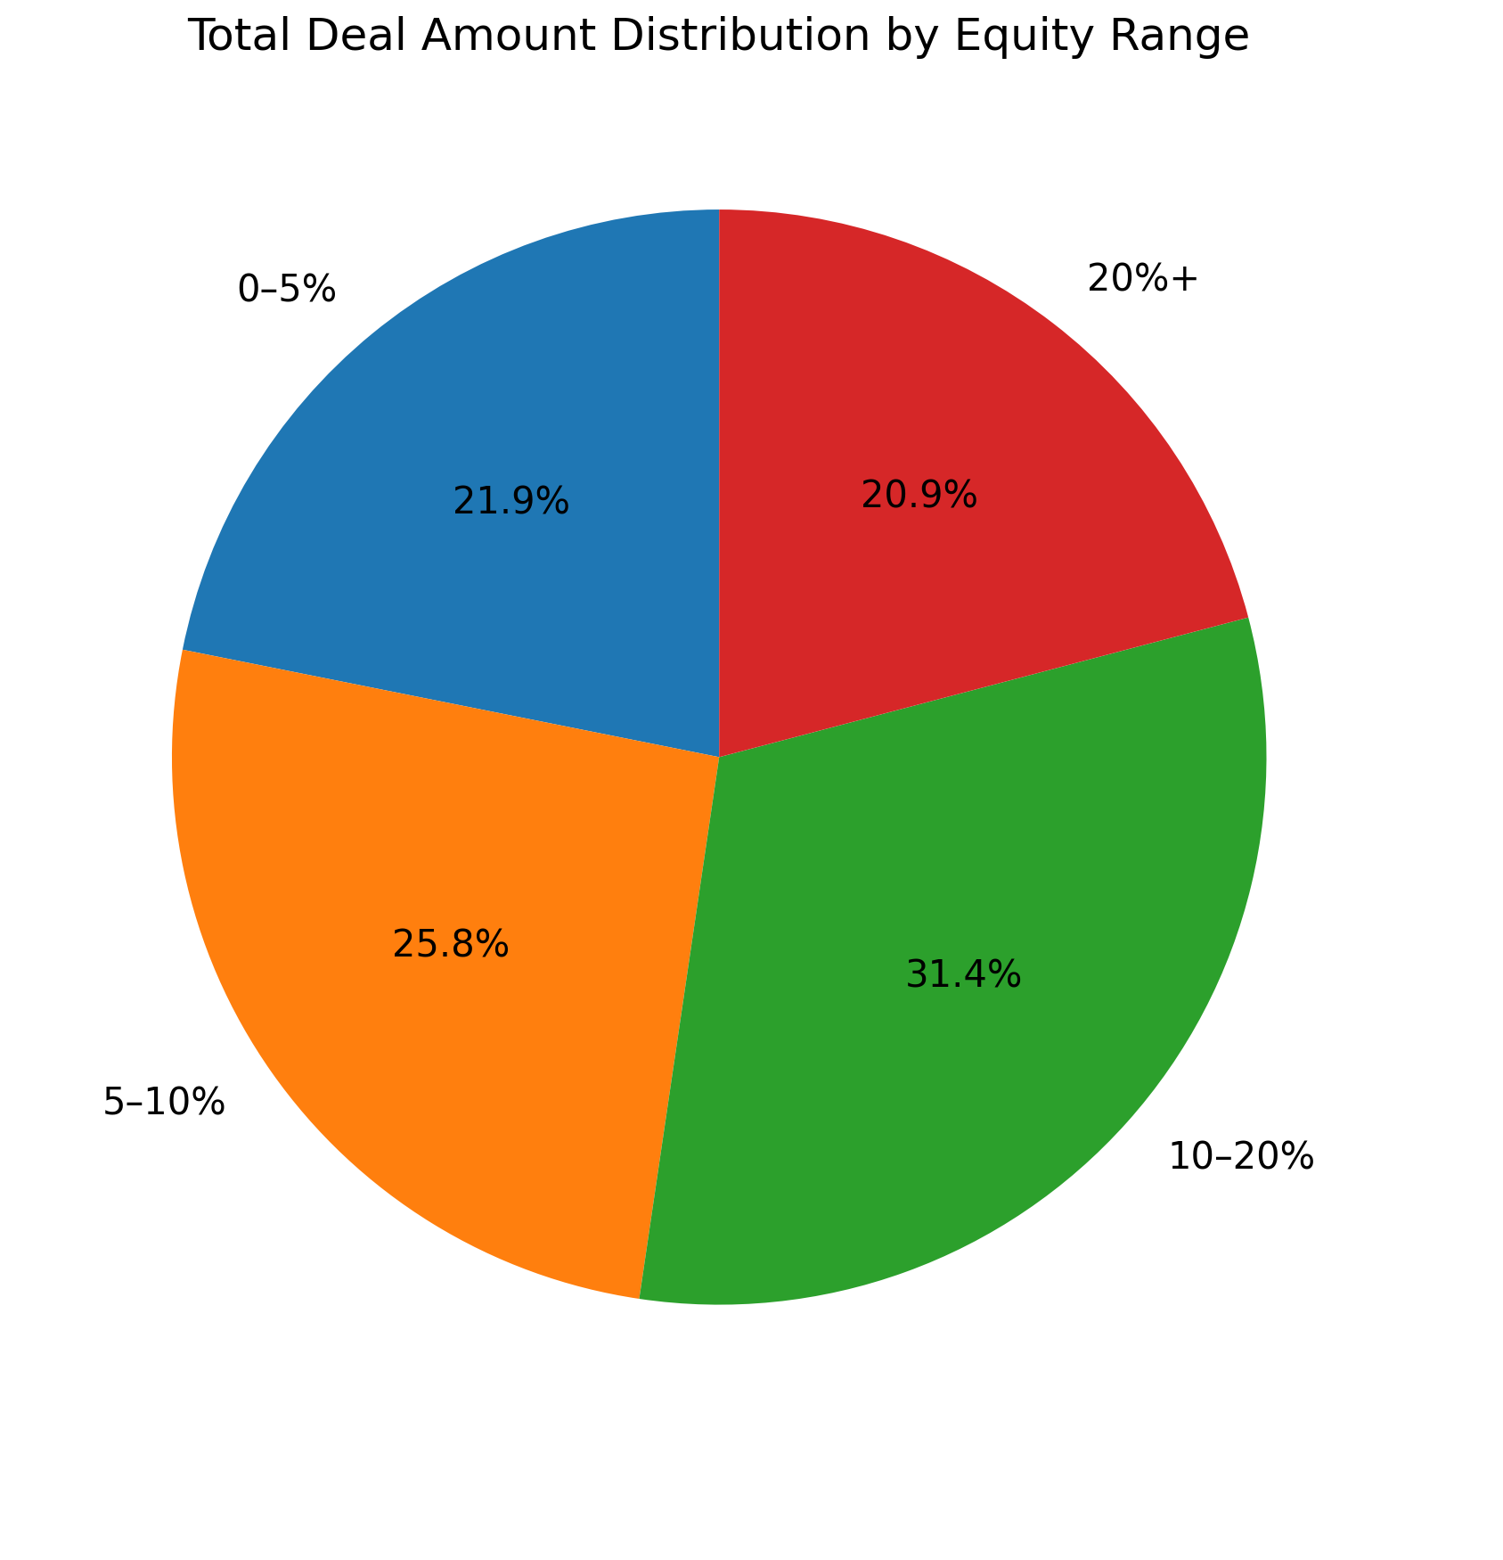
DEAL STRUCTURE
Ask Range, Shark Count & Equity Distribution
1
Low Ask Range
Primarily single-shark deals with quick decisions
2
Medium Ask Range
Sweet spot for multi-shark syndication and competitive bidding
3
High Ask Range
Requires consortium approach — higher deal amounts only when justified
Multi-Shark Patterns
Equity Concentration
Higher ask brackets naturally attract multiple investors
Majority of capital flows into 10-20% equity deals
Risk distribution drives consortium formation
Extreme dilution (>30%) is rare and avoided
Founders retain meaningful control in most deals
Shark synergy unlocks larger capital pools
Key Finding: Capital concentrates in moderate dilution zones — sharks avoid extreme ownership grabs, preferring balanced partnerships.

Slide 10
Final Conclusions & Strategic Takeaways
Visibility Alone Fails
Valuation Reality Check
Embrace Valuation Correction
Panel presence does not guarantee funding — business fundamentals drive all decisions
Unrealistic expectations dramatically reduce deal success rates — calibrate to market
Successful founders accept cuts & dilution to secure capital and expertise access
Multi-Shark Trade-offs
Efficiency Over Headlines
More sharks increase capital but often reduce efficiency — optimize strategically
Smart negotiation focuses on capital per equity point, not just deal size or valuation multiples
Project Impact
PYTHON
PANDAS
This analysis demonstrates how data analytics can decode real-world negotiation behavior using structured Python analysis and advanced visualization techniques.
NUMPY
MATPLOTLIB

Slide 11
Thank you

